Slide 1
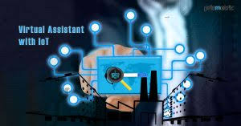
DESKTOP VIRTUAL ASSISTANT EXCITING INNOVATIONS THAT CAN CHANGE THE WORLD
NAMAN RAJ SHARMA

Slide 2
INTRODUCTION
What is Artificial Intelligence?
Concept of an Artificial Personal Assistant
Voice Control Personal Digital Assistants
The Combination Of:
Automatic Speech Recognition.
Natural Language Processing.
Artificial Intelligence.
Inter Process Communication

Slide 3
HISTORY
The first PDA was released in 1984 by Psion, the Organizer.
Early PDA's was devices having full keyboard and touch screen. Which was also known as PALMS.
The concept of virtual assistant was first developed by Joseph.
Weizenbaum of MIT in the late 60s.
The first chatterbot was "ELIZA".
"JULIA” is an example of the second generation chatterbot.
ALICE is example of the i generation chatterbot.

Slide 4
BASIC CONCEPTS USED
1
Natural Language Processing.
-To Understand user speech input.
2
Automatic Speech Recognition.
- To understand command according to user's input.
Artificial Intelligence.
- To learn things from user and to store all Information about behavior and relations of user..
3
Inter Process Communication
- To get important information from other software applications.
4

Slide 5
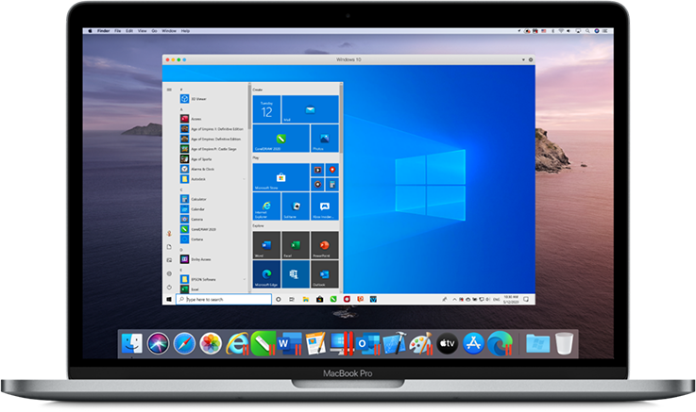
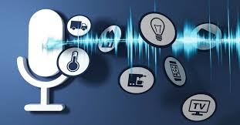
WORKING

Slide 6
THE THREE LAYERS
1
Speech to text:
A Piece of software used that converts audio to text. It doesn't understand just anything you might say.
2
Text Analyzing:
Converted text is just letters for computer. A place of software converts text to something that is understandable for computer. Computer understands the command, so Virtual Assistant like siri convert this to computer command. VPAS maps the words to functions and parameters to create a command that computer can understand .
3
Interpret commands:
In this layer, that mapped computer command, go to server through internet. a Simultaneously, your speech evaluated locally a local recognizer communicate with server to judge whether command will be best handle locally or not. Example Play Music, Restaurant renovation Movie Rating.

Slide 7
FEATURES
1.Open the YouTube, Google, Wikipedia in the browser.
2. Send an email to your contacts.
3. Tells you the current weather and temperature of almost any city.
4. Tells you the current time.
5. Greetings.
6. Play you a song installed in your laptop/desktop.
7. Tells you latest news feeds.
8. Tells you about almost anything you ask.
AND MUCH MORE...!!!!

Slide 8

ADVANTAGES AND DISADVANTAGES

Slide 9
+
-
SAVES TIME
HANDS-FREE OPERATION
EASE OF USE
CONVENIENCE
ACCESSIBLE AND INCLUSIVE
A MORE HUMAN TOUCH
COMPREHENSION
DIFFICULTIES
ETHICAL AND PRIVACY
CONCERNS
CONVERSATIONAL
SKILLS
INTERNET ACCESS
EXPENSIVE
WE CREATED THIS VIRTUAL ASSISTANT FOR DESKTOPS. TO MAKE IT EASY FOR THE USER TO DO MULTI-TASKING.

Slide 10
VPA IN FUTURE
Next step will be to strip back the physical hardware as far as possible.
With the intelligence of the VA existing in the cloud, getting pulled in, and pushing its way into our lives on multiple devices on our bodies and in our office, home, and vehicles.
ON Your WAY will be continually prompting you with suggestions and taking instructions, and will know more about you than perhaps you do yourself We can expect this device to be implanted and permanent.

Slide 11
CONCLUSION
Virtual Personal Assistants are very effective way to organize your schedule. Now there are many Smart Personal Digital Assistant applications available in market for various device platforms.
These new Software Applications are performing really well than PDA devices as they provided with all resources of your smartphone.
VPAs are also reliable than Human Personal Assistant because VPAS are more portable and you can use them anytime. They also have lot of information than any assistant as they are connected with internet.

Slide 12
Thank you

